Slide 1



Sri Sairam College of Engineering
Project Title :
Refactor Royale AI-Code Optimization game
Presented By
Vinutha S - 1SB22IS060
Kokila M - 1SB22IS020

Slide 2
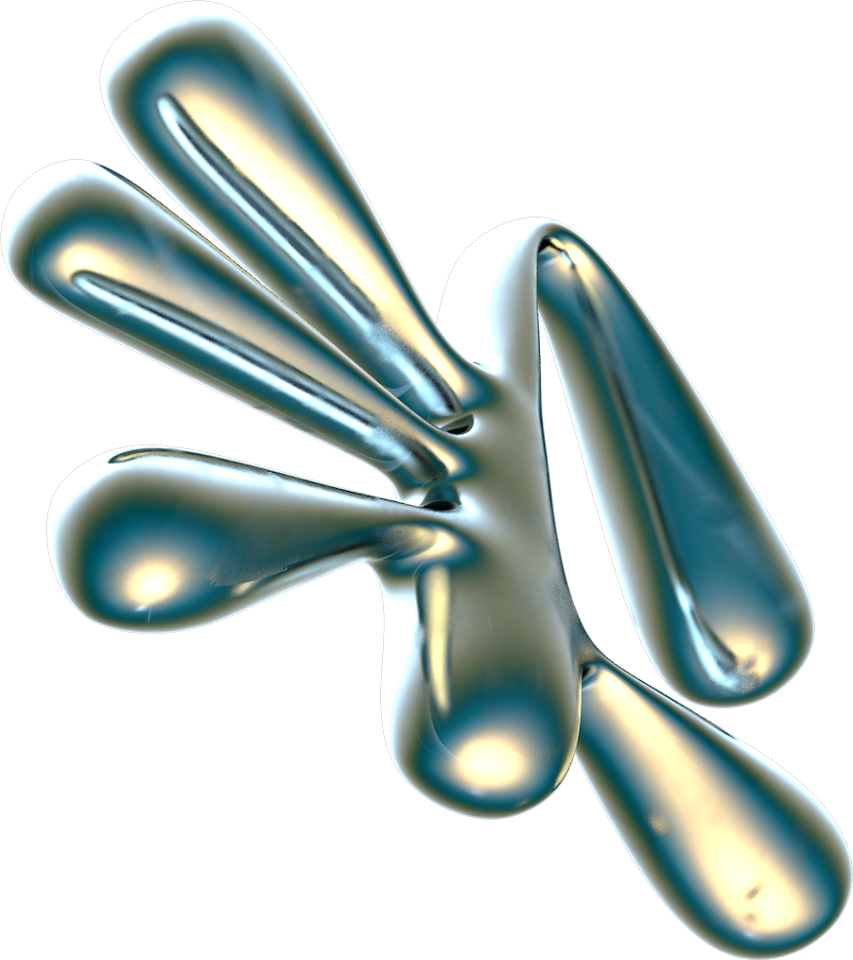
ABSTRACT:
Refactor Royale is an AI-driven code optimization game designed to enhance programming skills through interactive challenges. Players refine inefficient code using AI-generated suggestions, focusing on performance, readability, and best practices. The game employs machine learning to analyze and improve code iteratively, offering real-time feedback and ranking systems. With an engaging, competitive format, Refactor Royale transforms code optimization into a dynamic, educational experience for developers of all levels.

Slide 3
OBJECTIVE:
Develop an interactive, AI-powered coding game that challenges players to optimize and refactor code for efficiency, readability, and performance while competing against As or other players.

Slide 4
PROBLEM STATEMENT:
In software development, writing optimal, clean, and efficient code is a crucial skill. However, many developers struggle with understanding best practices for refactoring, performance optimization, and reducing technical debt.
Traditional learning methods, such as books and tutorials, lack engagement and real-time feedback, making it difficult for developers to improve their code refactoring skills in an interactive manner.

Slide 5
SOLUTION:
Refactor Royale an AI-driven competitive coding game where players are given pre-written code with inefficiencies and must refactor it to maximize efficiency, readability, and maintainability. The system evaluates solutions using AJ-based analysis, scoring based on execution time, space complexity, and coding best practices.

Slide 6
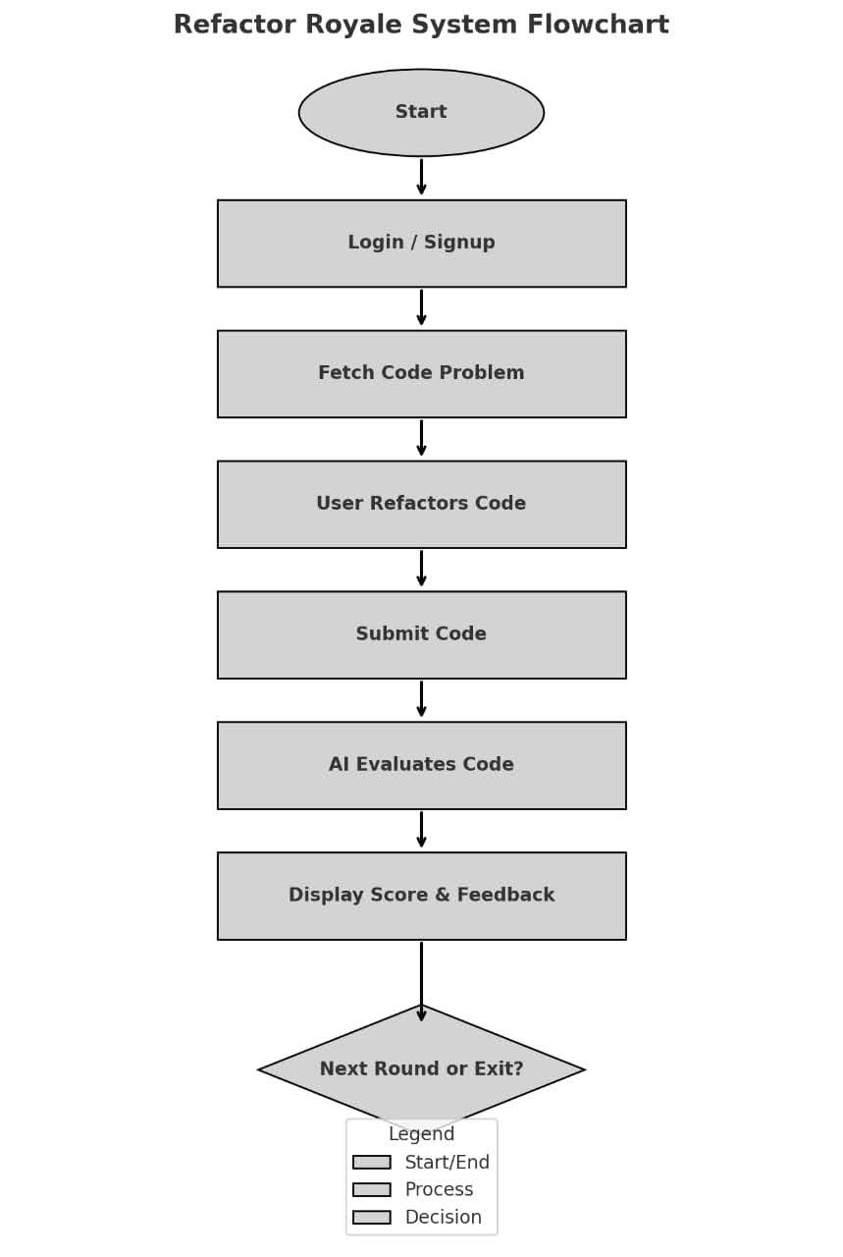

Slide 7
How we built Refactor Royale :
Refactor Royale is an AI-driven coding game designed to help developers optimize code efficiently. It consists of a backend AI evaluator, a React-based UI, and a gamified experience.

Slide 8
System Architecture
1. Frontend Development:
React.js - Core framework for building UI components (Key feature used is Hooks (useState, useEffect), Component lifecycle).
Vite - a Frontend build tool (used for Fast development server, Hot Module Replacement).
CodeMirror - a Code editor component (Python syntax highlighting, Live editing). React Confetti - a Celebration effect (Particle system for completion rewards).
CSS3 - Styling and animations (Neon glow effects, Grid/Flexbox layouts).

Slide 9
2. Backend Development:
Flask - Python web framework(Used a REST API endpoints, Request handling). Flask-CORS - Cross-origin resource sharing(for Secure frontend-backend communication). Python AST - Abstract Syntax Tree parsing(for Code structure validation). Subprocess - Process management(Running Ollama AI service).

Slide 10
3. AI & Optimization Engine
Ollama - Local LLM runner(Mistral 7B model execution). Mistral 7B - Large Language Model(used for Code analysis & optimization suggestions). Tenacity - Retry library (Auto-retry failed AI requests).
LRU - CachePerformance optimization(Memoization of complexity calculations).

Slide 11
4. Game Logic & Evaluation
Components used and implementation -
Challenge Pool - 10 Python problems with test cases (O(1) to O(n!) complexity). Scoring System - Dynamic scoring (5-10 points) based on optimization level.
Time Tracking - Countdown timer with 15-minute limit.
Progress System - Tracks solved challenges (10/10) with persistent scores.

Slide 12
5. Styling & UI Effects
Technology and Key Visual Elements-
CSS Neon Effects - Glowing borders, text shadows, pulsating animations.
Glassmorphism - Frosted glass UI panels with backdrop blur.
Keyframe Animations - Pulsing lights, input field highlights
Responsive Design - Mobile-friendly layouts using CSS Grid/Flexbox.

Slide 13
6. Development Tools
Tool and Usage -
Git - Version control ESLint - JavaScript code quality
Prettier - Code formatting Postman - API endpoint testing
Chrome DevTools - Debugging frontend performance

Slide 14
7.Core features and Flow
User Login & Progress Tracking - Users log in and track optimization progress.
Fetch Code Challenge - AI fetches a randomly chosen code snippet with inefficiencies.
User Refactors Code - The player submits an optimized version of the code.
AI Evaluation - AI model analyzes code improvements:
1. Time Complexity 2. Readability 3. Maintainability
Scoring & Feedback - AI gives a score and detailed feedback.
Leaderboard & Gamification - Users see rankings and achievements.

Slide 15
8. Key Python Libraries
python
Backend Dependencies
flask==2.0.1 # Web server flask-cors==3.0.10 # Cross-origin support requests==2.26.0 # HTTP calls to Ollama tenacity==8.0.1 # Retry mechanism python-ast==3.8 # Code parsing
uuid==1.30 # Session management

Slide 16
9. Hardware Requirements
Minimum: CPU with AVX support (for Ollama) Recommended:
1. NVIDIA GPU (for faster AI inference) 2.16GB RAM (for smooth Ollama operation)
This stack was chosen for its:
Efficiency : Lightweight yet powerful tools Educational Value : Demonstrates real-world AI integration Visual Appeal : Neon theme enhances engagement Scalability : Ready for cloud deployment
The project uniquely combines gaming aesthetics with practical computer science education through carefully selected technologies.

Slide 17
AI model for code evaluation
Uses Mistral 7B to code analysis and optimization suggestions.
Evaluates time complexity, maintainability, readability.
Provides real-time feedback with improvement suggestions.

Slide 18
Backend API Design (Flask API)
submit - Accepts user code and evaluates leaderboard - Retrieves top scores
Uses AI model to process code asynchronously

Slide 19
UI/UX Development
Code Editor ( Mistral 7B Editor) Submit Button (Triggers evaluation) Score & Feedback Display Leaderboard for gamification

Slide 20
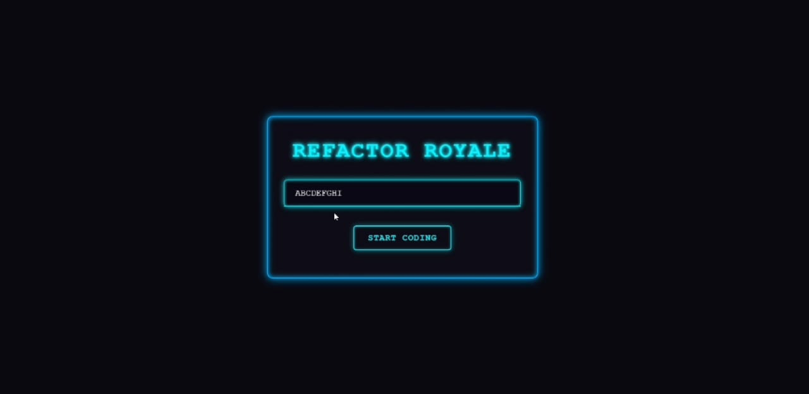
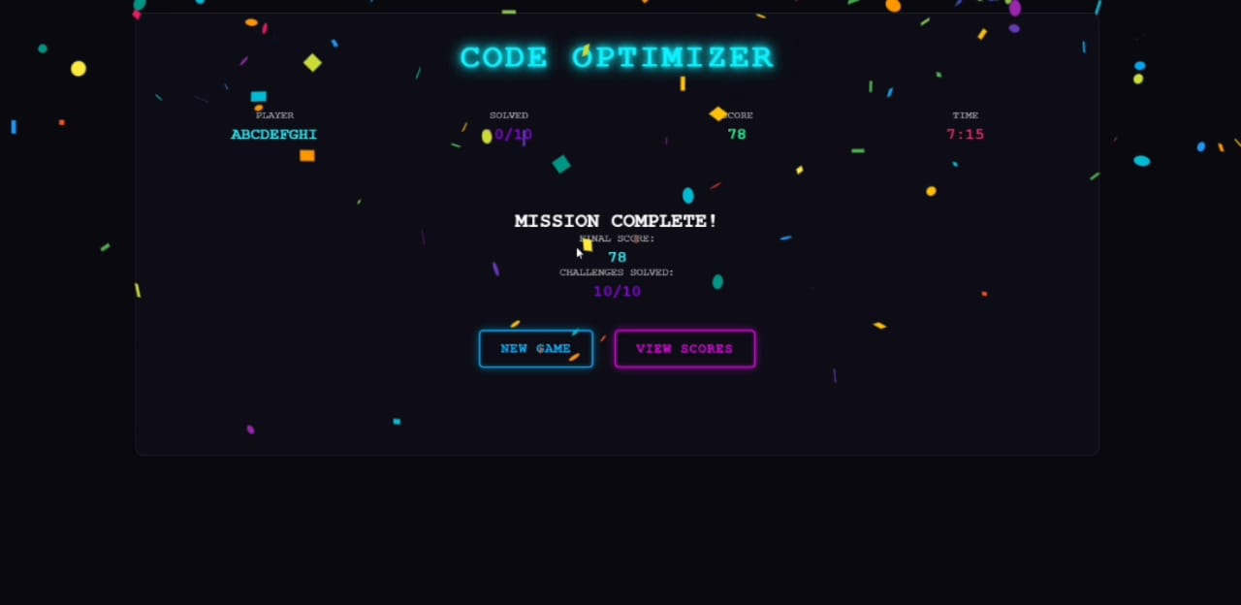
Demo video
Video Link https://drive.google.com/file/d/1s3zrgcRIV03sTJb_CwdtLQ25UlSDp1tL/view?usp=drivesdk

Slide 21


THANK YOU

